Slide 1
RETHINKING THE VALUE OF NETWORK PRUNING(ICLR 2019)
胡超杰
2018.10.26

Slide 2
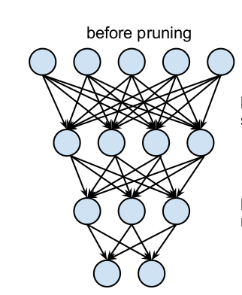
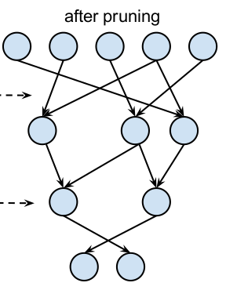
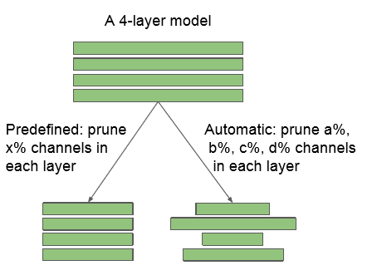
NETWORK PRUNING
Non-structured Pruning
Structured Pruning

Slide 3
Learning Efﬁcient Convolutional Networks through Network Slimming
ICCV 2017

Slide 4
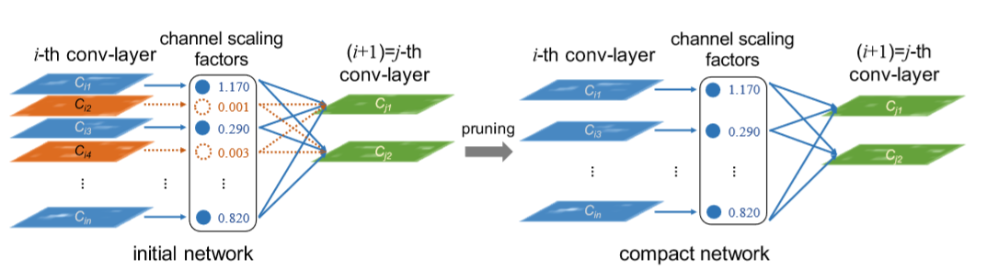
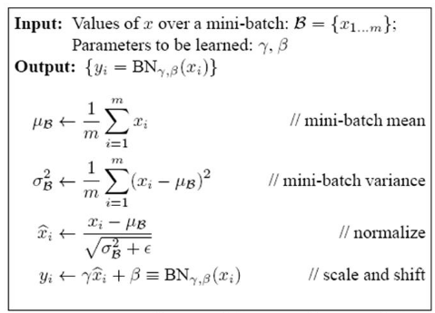

Network Slimming
$$γ$$

Slide 5


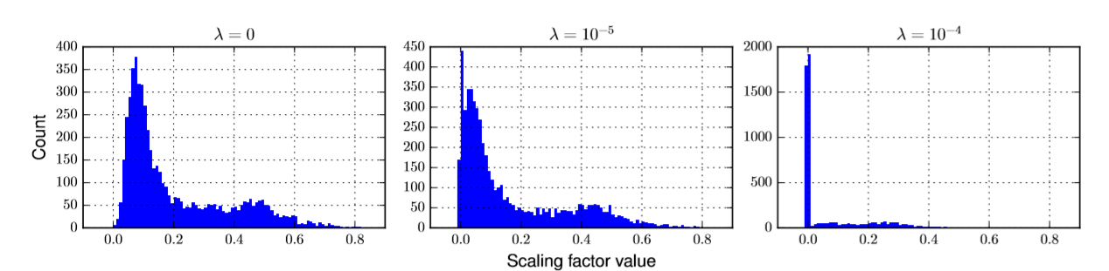
Network Slimming

Slide 6
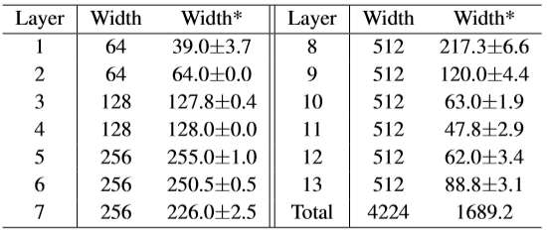
Network Slimming
VGG-16

Slide 7
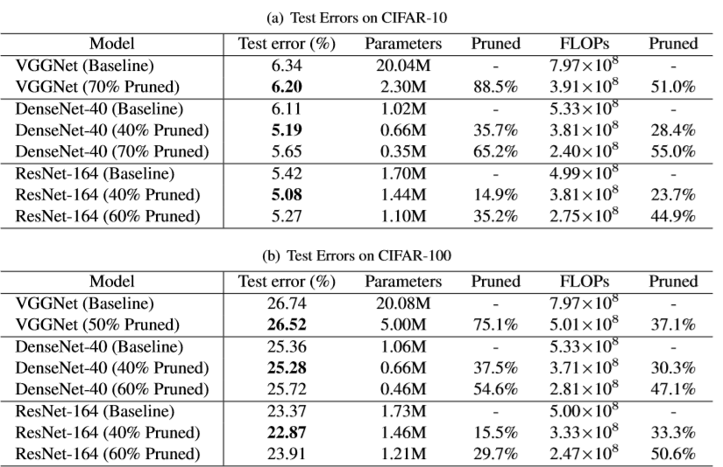
Experiments

Slide 8
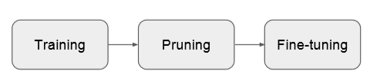
RETHINKING THE VALUE OF NETWORK PRUNING
ﬁne-tuning the pruned model with inherited weights is no better than training it from scratch.

Slide 9
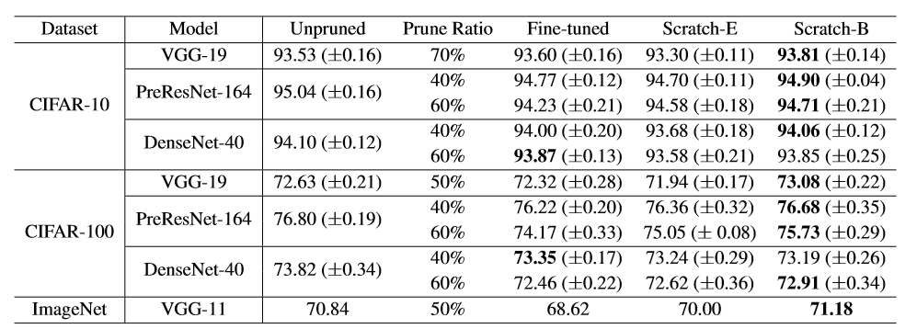
Experiments
Network Slimming

Slide 10
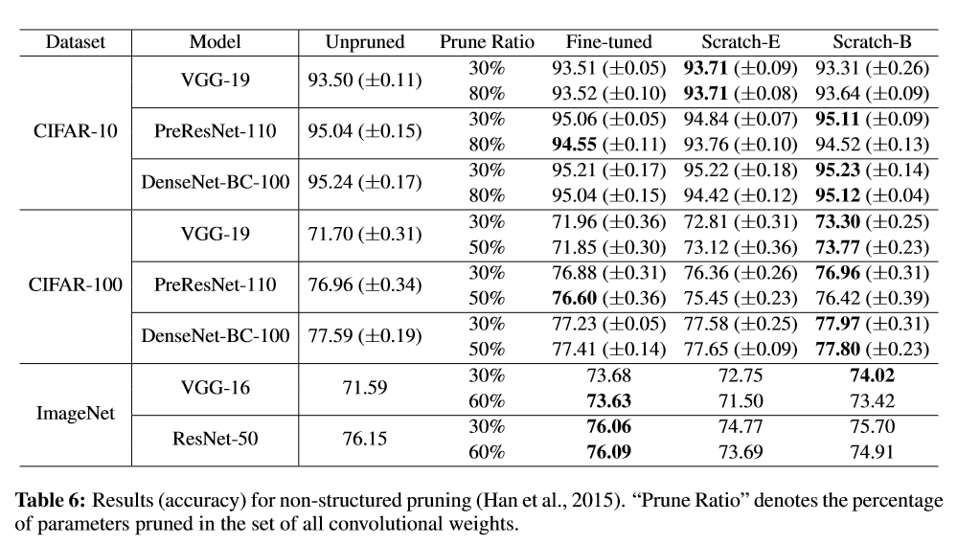
Experiments
non-structured pruning

Slide 11
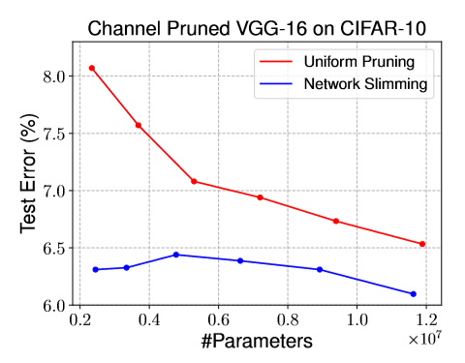
Experiments
Parameter Efﬁciency of Pruned Architectures

Slide 12
THANKS!

